Slide 1
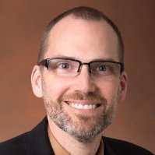
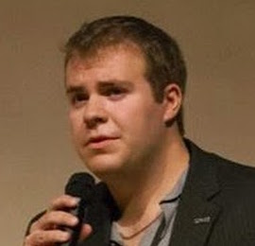
COmplex Data EXplorer
DSWG MMR
Know
Thy
Data
Dr. Lukas Mandrake
Jack Lightholder
CODEX
Jun 22 2017

Slide 2
Cross-Industry Standard Process for Data Mining
CODEX facilitates:
Data Understanding
Data Preparation
User Need
Don’t rewrite
Matlab / Python:
Later Analysis Unchanged
Just Better Data + Understanding
Existing framework CRISP-DM
“De-Facto Data Mining Methodology”¹
1 - Marbán, Mariscal, Segovia (2009); A Data Mining & Knowledge Discovery Process Model.
ISBN 978-3-902613-53-0, pp. 438-453, February 2009, I-Tech, Vienna, Austria. Wikipedia
Dr. Lukas Mandrake

Slide 3
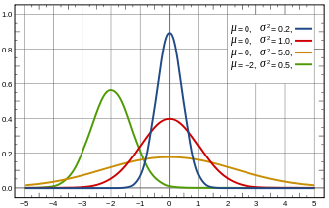
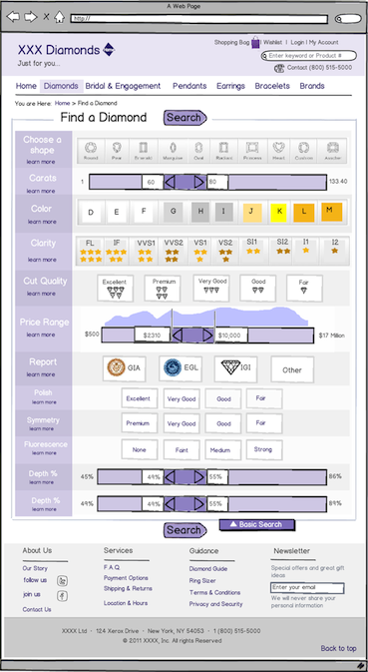
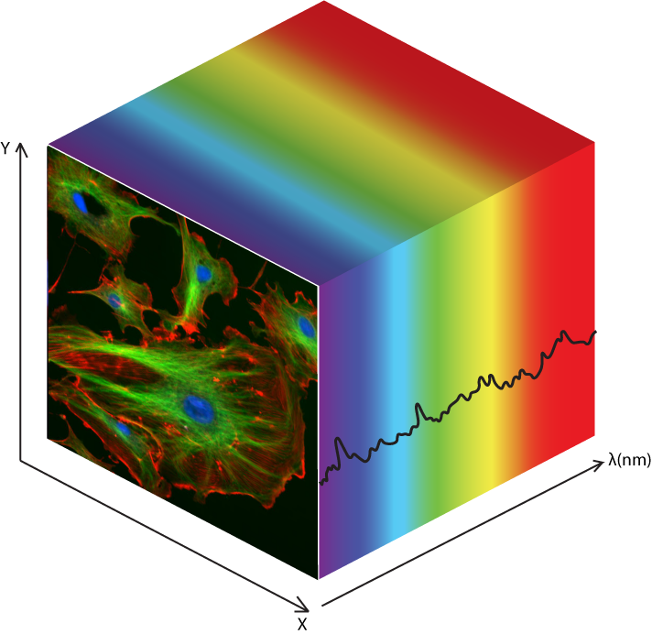
Guided Exploration = Fast Understanding
Initial Behavior Analysis
-Understanding-
Informed Decisions
-Instant Guidance-
How much data would this keep?
“Of 2740 columns, there are 4 groups by behavior. 1 is unique.”
Problem entries, repeat values, missing stats for each column
Innately Multi-dimensional
Machine Learning
-Discovery-
How much time / memory would this take?
What are most “important” columns? Why is this sub-population different?
How many kinds of data are there? What data are likely outliers? Why?
No decision without guidance
Intuitive interface gives you help without words

Slide 4
Functionality for DSWG Pilot
Dr. Lukas Mandrake
Back End
Front End
Focus on 1D data
Data Sources:
OCO-2
Workplace Survey
SmartSpec
Capability | Status |  | Capability | Status
Data Reader | Done |  | User Interviews | Done
Dimension Red. | Done |  | Powerpoint prototype | Done
Peak Finding | Done |  | Downselect Interf. Arch. | Done
Template Scan | Done |  | Row Subsets | Working
Endmembers | Done |  | Clustering | Working
Correlation | Done |  | Bad Value Report | Working
Segmentation | Done |  | Save Subset | Done
Clustering | Done |  | Explain This | Working
Regression | Done
Named Subsets | Done
Bad Value Report | Done
Save Subset | Done
Explain This | Working

Slide 5
Budget vs. Actual
Dr. Lukas Mandrake
Sprints

Slide 6
Interface Lessons Learned
Dr. Lukas Mandrake
It’s all about the interface (because I had Jack for back-end)
Designers seek to find the “best” interface
May be impossible until strawman exists
Do not conduct user interviews until strawman!
Need very firm hand – creative types
Recommend Agile development methods:
WILL check in code regularly
WILL only commit working versions
WILL implement skeletal versions for study
Avoid war-room mentality: slow and steady
Takes more time than (I) would predict

Slide 7
Remaining Work
Dr. Lukas Mandrake
Currently back-end heavy (but that’s ok)
Keep pushing Interface group to implement more func
No wasted effort
Try to make current group work on direct interface only
Seek alternative interface support
Will finish out DSWG with Davidoff’s group
Taking other recommendations now for FY18
We have ~$200k from AMMOS Technology for FY18!!

Slide 8


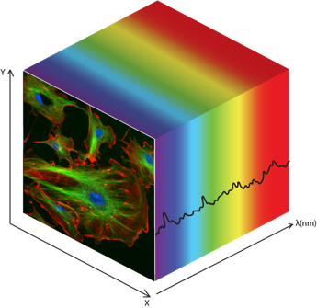
Complex Data Explorer (CODEX)
Jet Propulsion Laboratory
California Institute of Technology
Task Lead: Dr. Lukas Mandrake, 398J (Machine Learning)
Objective(s):
Create a graphical application to enable:
Rapid survey of what’s in a dataset trends / problems / groups / correlations
Informed selection of optimal subset for deep analysis
JPL Significance:
Hidden anomalies and high dimensions commonly interfere with Ops, Cal/Val, Algorithm Dev, & Science Prod. CODEX decreases mission risk, increases data understanding, and speeds analysis.
Key Milestones:
Mar: design document for specific functionality
Apr: prototype software architecture / data loaders
May: prototype ML capabilities selected
Jun: prototype interface developed
Jul: predictive parameter selection
Sep: Real Test Cases + demo prototype to DSWG
Approach:
Combine existing data analytic algorithms
Develop intuitive, elegant interface (Davidoff)
Provide guidance to facilitate Data Science decisions
Output selected subset w/ code for generating result
Resources Requested: $50k labor
Products:
Desktop-based GUI application for data exploration
Current TRL 1 tech will advance to TRL 3
(Limited functionality to validate critical concepts)
Success Criteria:
>50% reduction in time-of-analysis for user community
Real OCO-2 + upGREAT/SOPHIA
Statements of support from eng, sci, & data sci users
Data Science Working Group
Data Science Pilot

